Slide 1
Rentscout
By Control, Alt, Defeat

Slide 2
So what was our vision?
A standardized process for college students to find houses
Allows students to filter a wide array of houses per their needs
Let renters give feedback on Landlords and Houses which might be missed during house tours.

Slide 3
So what’s have we accomplished?
A standardized process for college students to find houses ✅
Allows students to filter a wide array of houses per their needs ✅
Let renters give feedback on Landlords and Houses which might be missed during house tours. ✅

Slide 4
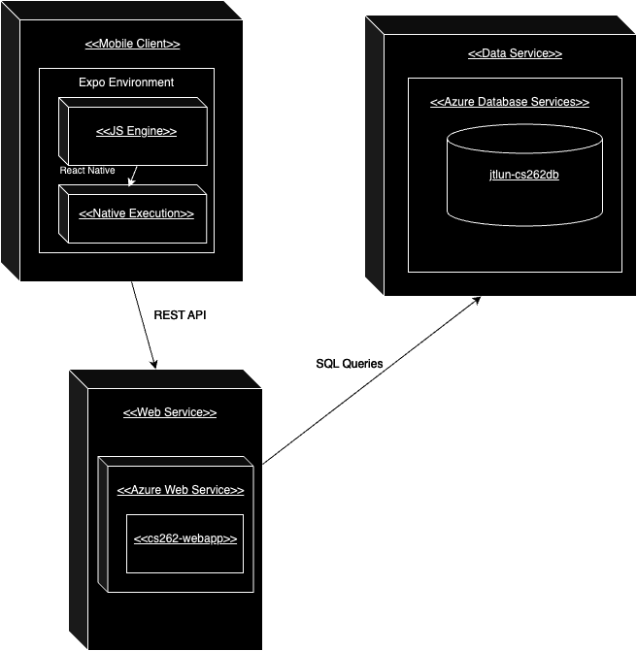
Deployment Diagram

Slide 5
Ethical Implications per Postman ideas:
Tech giveth and taketh away
Tech gives unequal benefits
Tech is centered around a powerful idea
Tech leads to Ecological Change
Tech is Mythic

Slide 6
Ethical Implications per Postman ideas:
2. Tech gives unequal benefits: More power into the hands of the renter, can be abused.
3. Tech is centered around a powerful idea: The housing market would improve for renters and landlords if there were more feedback.
4. Tech leads to Ecological Change: It would radically change the way renting was done.

Slide 7
Usability Feedback
Functionality issues
Keyboard wouldn’t close out of search box
Filters wouldn’t refresh
Language issues
Eg. #beds -> #bedrooms
Aesthetic issues
Moving the favorites button
Changed filter and sort buttons to look more like buttons
Remove splash page

Slide 8
Strengths and weaknesses of our app.
Pros
Cons
Simplicity / ease of use
Favorites List
Completed filters page
Feedback user authentication
Potential Future Changes:
Filling out database
Adding landlord functionality
Incorporate apartments
Help renters find each other
Expand to other colleges

Slide 9
Thank you!

